Slide 1

Trending YouTube Videos (5/31/2018)

Slide 2
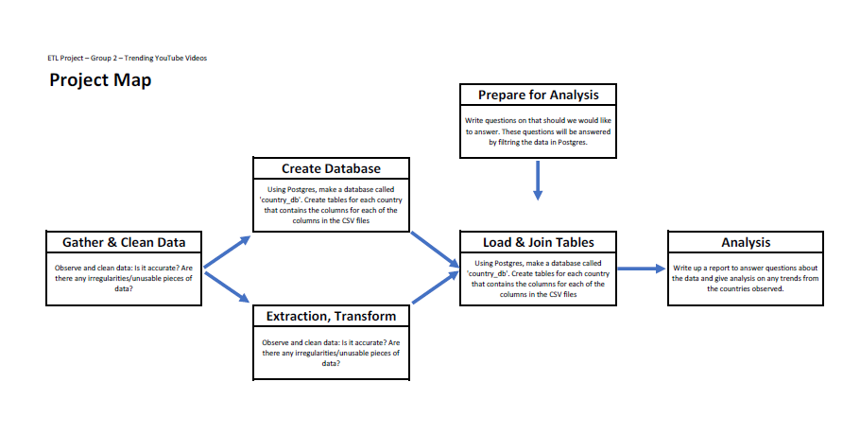

Slide 3
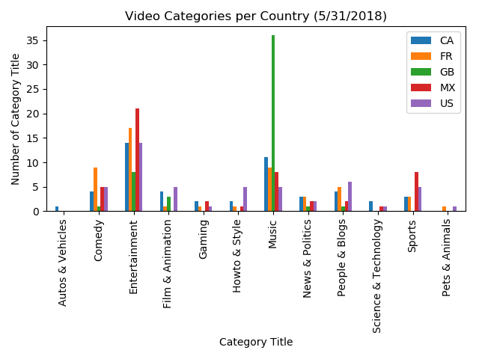

Slide 4
QUESTIONS?

